Slide 1

Authorship Verification Using Impostor Projections and Siamese Networks
25-1-R-17
Adir David - 206132029
Eyal Maklada - 206459166
Supervisors:
Prof. Zeev Volkovich vlvolkov@braude.ac.il
Dr. Renata Avros ravros@braude.ac.il

Slide 2
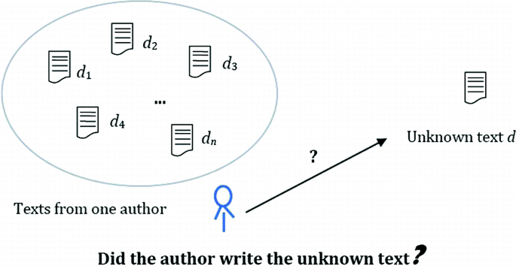
Authorship Verification Problem
Authorship verification determines whether two given texts are authored by the same individual.
Applications
Digital Forensic
Academic Integrity
Text Analysis Applications
Determining issues of doubtful authorship
Classic example: The controversies over the authorship of the Shakespeare Apocrypha.
Notes:
Digital Forensics Importance: Authorship verification ensures integrity in digital forensics by validating the origin of electronic documents.
Academic Integrity Maintenance: It upholds academic integrity by confirming authorship, thereby preventing plagiarism and fraudulent practices.
Text Analysis Applications: In text analysis, it enhances credibility through accurate attribution, benefiting linguistic and stylistic research.
The Shakespeare Apocrypha is a group of plays and poems that have sometimes been attributed to William Shakespeare, but whose attribution is questionable for various reasons.

Slide 3
Challenges in Traditional Methods
Adversarial Mimicry Challenges
Short Text Limitations
Feature Representation Issues
Notes:
Adversarial Mimicry Challenges: Adversarial mimicry techniques complicate authorship verification by generating deceptive texts that closely imitate genuine writings.
Short Text Limitations: Traditional methods struggle with short or fragmented texts, often yielding unreliable authorship conclusions from minimal data.
Feature Representation Issues: Inaccurate feature representation in conventional models can lead to significant misidentifications and reduced verification efficacy.

Slide 4
Proposed Framework
Based on the work of our supervisor Zeev Volkovich:
Text classification using “Impostor” Projections Method.
12th International Symposium on Foundations of Information and Knowledge Systems, Helsinki, June 2022
State-of-the-art Neural Network Siamese Networks
Innovative Adversarial Training Technique Impostor Projections
Inference Pipeline
Signal Construction
Dynamic Time Warping
Isolation Forest Algorithm
K-Medoids Clustering Algorithm
Notes:
Proposed Framework Overview: Our framework integrates advanced techniques to enhance authorship verification, ensuring authenticity across varied domains.
Innovative Techniques Utilization: Incorporates Siamese networks and adversarial training to improve accuracy, scalability, and robustness in verification.
Holistic Verification Approach: Emphasizes a comprehensive methodology that addresses traditional limitations while maximizing efficiency and effectiveness.

Slide 5
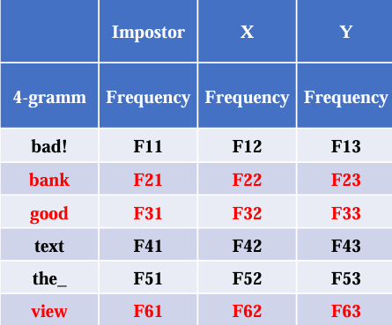
The Impostors Projection Method
The Impostors Method checks whether document X is stylistically more similar to document Y than each of the impostors' documents taken from a given collection, such that the evaluation is performed resting upon a collection of randomly chosen feature subsets. The “similarity” of X to Y is the fraction of the scores where X and Y are “closer” to each other than to the impostors set.
Notes:
Impostor Projections Defined: Impostor projections represent fabricated authorship samples simulating genuine texts to evaluate verification robustness.
The method checks whether X is more similar to Y than each of the impostors taken from a given collection, such that the evaluation is performed resting upon a collection of randomly chosen feature subsets. The “similarity” of X to Y is the fraction of the scores where X and Y are “closer” to each other than to the impostors set
The Many-Candidates Problem: Given a large set of candidate authors, determine which, if any, of them is the author of a given anonymous document.
A proposed solution to the many-candidates problem is provided in Koppel, M. and Winter, Y.(2014). Determining if two documents are written by the same author.
Therefore we can reduce the verification problem into the many-candidates problem by generating a large set of impostor candidates.
The method inherits all the listed disadvantages of the mentioned earlier representation:
● The method does not respect the semantics of the N-grams ignoring their order. Discarding the order ignores the context and meaning in the document (semantics).
● The method compares merely one-dimensional marginal distributions of N-grams.
● N-grams distributions can be estimated appropriately just for sufficiently long texts. Thus, small patterns are not captured
1. Generate a set of impostors Y1,…,Ym (as will be specified below).
2. Compute scoreX(Y) = the number of choices of feature sets (out of 100) for which sim(X,Y) > sim(X,Yi), for all i=1,…,m.
3. Repeat the above with impostors X1,…,Xm and compute scoreY(X) in an analogous manner.
4. If average(scoreX(Y),scoreY(X)) is greater than a threshold σ*, assign to same-author.

Slide 6
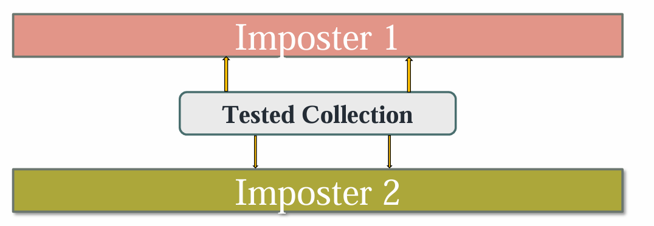
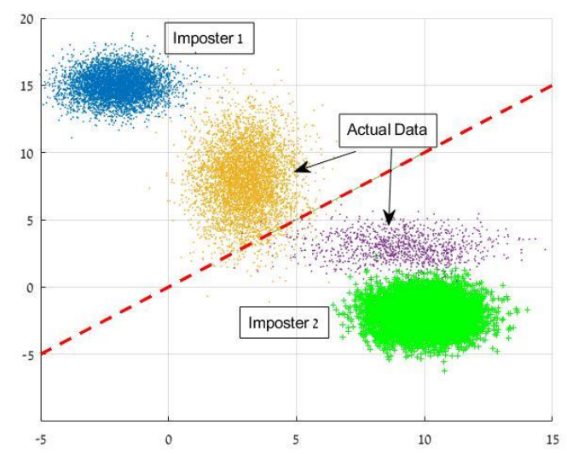
The "Deep" Impostors Projection Method
The Deep Impostors Method is based on labeling of sequential small fractions of the texts in the tested collection through a deep network trained on an impostors' pair.
At each step, a deep network is trained and provides a separating manifold (the red dotted line in the image). A text under consideration is classified according to the splitting rule generated by the previously trained network and then transformed into a signal.
Notes:
Deep Impostor Projections Method: The deep variant of the method explained earlier is inspired by the methodologies and works of Zeev Volkovich.
The method is based on labeling of sequential small fractions of the texts in the tested collection through a deep network trained on an impostors' pair.
Adversarial Scenario Creation: Creating adversarial scenarios using impostor projections tests model resilience against deceptive authorship manipulation strategies.
Training Process Enhancement: Integrating impostor projections during training optimizes model adaptability to real-world authorship verification challenges.

Slide 7
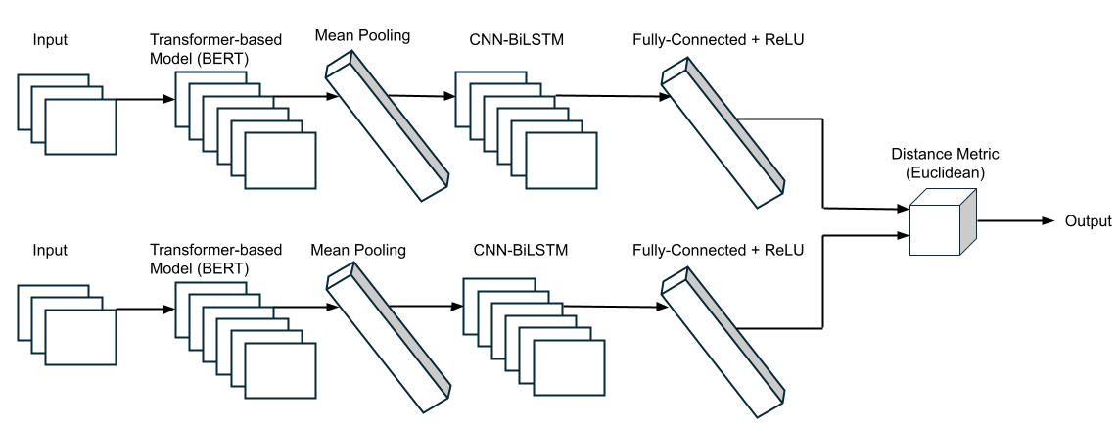
Proposed Siamese Model Architecture
Notes:
Mean Pooling: Reduce embedding to fixed sized vectors 1x768
Fully-Connected + ReLU: The input data into an embedding space where similar inputs are closer.

Slide 8
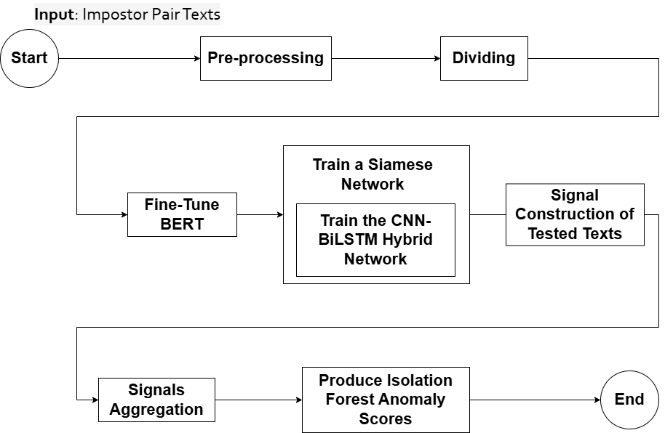
Framework Flow Chart
Input Processing.
Embedding Generation.
Embedding Refinement and Feature Retention.
Siamese Networks for Pairwise Similarity.
Signal Construction and Aggregation.
Anomaly Detection.
Notes:
Input Processing: The initial stage involves preprocessing the input text to ensure consistency and readiness for analysis.
Embedding Generation: Transforming processed text into dense vector representations captures linguistic features essential for comparison.
Anomaly Detection: Identifying outliers in authorship verification helps to spot unusual patterns indicative of forged texts.

Slide 9
Procedure
Given two collections sets: texts under classification (tested collection texts) and impostor texts.
During training, we apply the deep impostor's projection method using impostor texts.
Anomaly Scores = []
For each impostor pair:
Pre-process and divide into batches & chunks.
Train a Siamese network.
Assign chunks of the tested collection texts
Signal construction and aggregation to produce signal representation.
DTW algorithm.
Anomaly scores vector produced by the Isolation Forest algorithm run over a DTW matrix.
Append vector to Anomaly Scores list.
Clustering algorithm K-Medoids; K = 2, to provide categorization of the texts into groups of interest.
For each impostors' chunk pair:
Embeddings generation.
Feature extraction, retention and embedding refinement.
Pair comparison to produce pairwise similarity and label the chunk pair.

Slide 10



Input Processing
Lemmatization and Punctuation Mark Removal.
Text Tokenization using BERT’s WordPiece Tokenizer.
Chunking Methods.
Text
Batch 1
…
Batch $i$
…
Chunk 1
Chunk 2
Chunk $k$
…
Chunk
$$(i −1 ) ∗ k+1$$
…
Notes:
Tokenization Techniques: Tokenization breaks text into smaller components, facilitating meaningful analysis by preserving contextual relationships.
Chunking Methods: Chunking organizes tokens into grammatical units, enhancing syntactic structure understanding for more accurate processing.
Impact on Analysis: Effective preprocessing through tokenization and chunking improves subsequent model performance in authorship verification tasks.
Lemmatization involves grouping together the inflected forms of the same word

Slide 11
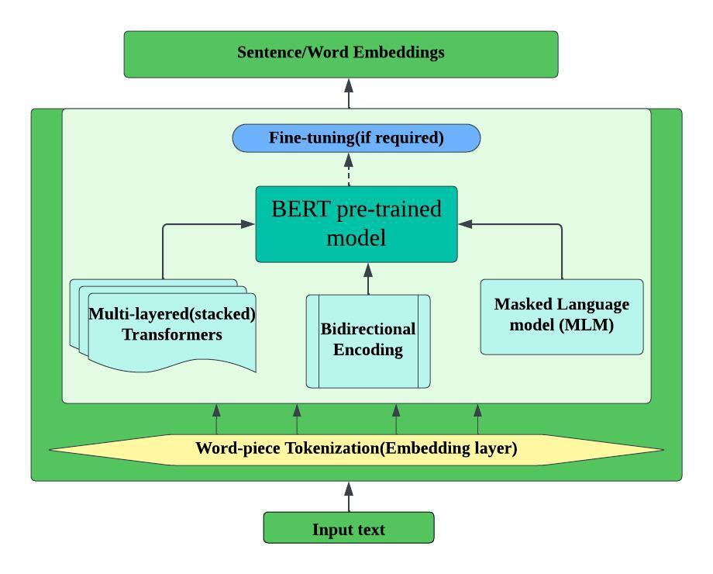
Embedding Generation with BERT (English)
Pre-trained Language Model.
Generates Deep Contextualized Word Embeddings.
Represents Words as Vectors in a Multi-Dimensional Space.
Improved Semantic Understanding.
Transfer Learning Benefits.
Supervised Fine-Tuning.
Optimizable using AdamW.
Assumes the core structure of the English language is preserved.
Notes:
This slide introduces BERT as a pre-trained language model used for embedding generation.
BERT creates deep contextualized word embedding, meaning it captures word meanings based on their context.
It represents words as vectors in a multi-dimensional space, improving semantic understanding.
Transfer learning benefits allow fine-tuning on specific tasks while preserving core language structures.
We optimize embeddings using AdamW, ensuring stable and efficient training.
------------------------------------------------------------------------------
BERT stands for Bidirectional Encoder Representations from Transformers
Contextual Embeddings: Pre-trained BERT generates contextual embeddings, capturing nuanced semantic relationships crucial for authorship analysis.
A way to represent words as vectors in the multi-dimensional space where the distance and direction between vectors reflect similarity and relationships among the corresponding words.
Improved Semantic Understanding: BERT's architecture allows for deep semantic understanding by considering left and right contexts of every token in every sentence, thus enhancing the model's ability to differentiate author styles.
Transfer Learning Benefits: Utilizing BERT leverages transfer learning, adapting prior knowledge to improve performance in specific authorship tasks.
Supervised Fine-Tuning: Pre-trained BERT models are first trained on large unlabeled corpora with objectives such as masked language modeling and next sentence prediction, allowing the model to learn general language representations. They can then be fine-tuned with comparatively smaller, labeled datasets to adapt these representations to a specific downstream task, such as authorship verification. This fine-tuning process slightly updates the model parameters so that BERT can use its deep understanding of the context of language and, at the same time, focus on task-specific features. It is worthwhile to mention that fine-tuning usually adopts strategies like using a Siamese network architecture, to further enhance the model's ability in sequential dependencies.
Optimizable using AdamW: Optimization techniques, such as using the AdamW optimizer in the right learning rates for the task at hand, shall guarantee that the fine-tuned model is robust and overfitting is avoided.
Assuming that the language has been relatively unchanged

Slide 12


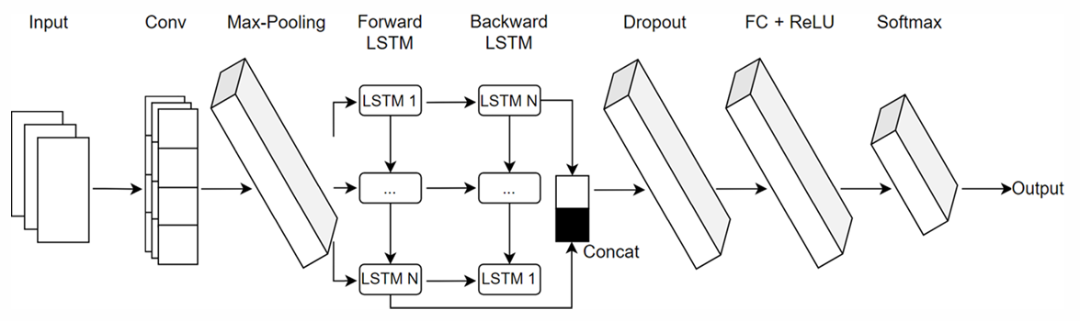
Embedding Refinement and Feature Retention
CNN extracts localized features such as lexical patterns.
Bi-LSTM incorporates the features with past and future context.
Proposed CNN and Bi-LSTM hybrid
Advantages
Synergy between localized feature extraction and global sequential modeling.
Richer representation of features.
Temporal dependency awareness.
Notes:
Once embedding are generated, we refine them for better feature retention.
A hybrid model using CNN and Bi-LSTM enhances the embedding.
CNN captures local lexical patterns, while Bi-LSTM retains sequential dependencies in text.
This combination provides richer representations and improves temporal awareness.
------------------------------------------------------------------------------
CNN Feature Extraction: Convolutional Neural Networks efficiently extract local features, capturing intricate stylistic elements in authorship verification.
In the use case of a vector embedding input, CNN filters then capture local stylistic patterns within these representations, generating a richer representation of
features.
BiLSTM Sequential Modeling: Bidirectional LSTM incorporates these localized features with past and future context, enhancing text analysis with temporal dependency awareness, thus obtaining more comprehensive and context-sensitive embeddings.
Hybrid Model Advantages: Combining CNN and BiLSTM leverages strengths of both, improving robustness and adaptability in verification tasks.
The integration of CNN and BiLSTM layers brings synergy between localized feature extraction and global sequential modeling.
* CNNs are very good at extracting fine-grained stylistic cues, such as lexical patterns or punctuation, which may appear within short fragments of text. These features often form the core stylistic patterns that characterize an author.
BiLSTMs then track how these patterns evolve and interact throughout the text, capturing broader stylistic and structural dependencies.
The softmax layer is in context of fuzzy classification:
Instead of a strict probability distribution (as in softmax, where outputs sum to 1), the output vector in a fuzzy system reflects how strongly the input belongs to each class, without requiring normalization to 1.

Slide 13
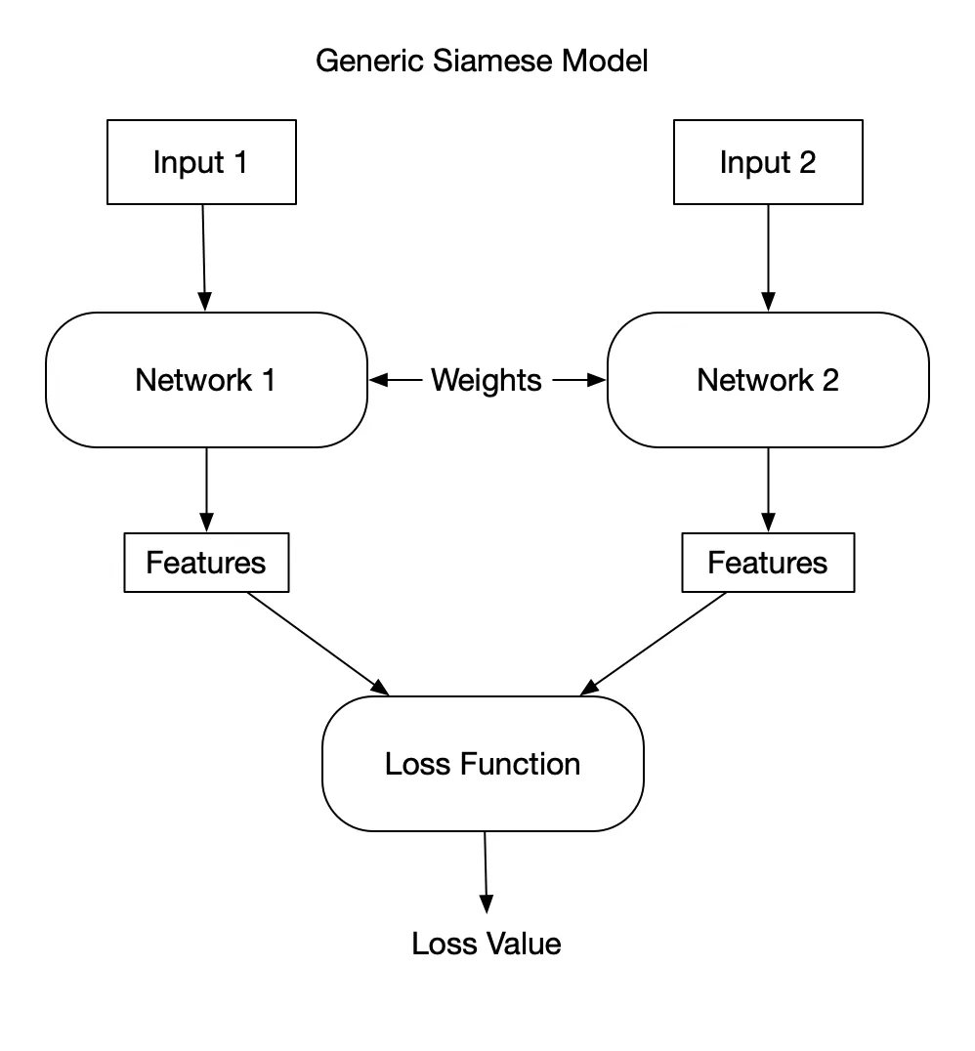
Siamese Networks for Comparison
Siamese networks are a type of neural network architecture that are efficient for:
Pairwise comparisons.
Learning to minimize or maximize distance between embeddings.
Learning similarity functions that generalize well to unseen text pairs.
Optimized using the binary cross-entropy loss function for loss calculation.
Adept at handling text variability, adversarial mimicry, and sparse datasets.
Notes:
Siamese networks are ideal for comparing text pairs.
They learn to minimize or maximize distances between embeddings, allowing them to determine similarity.
These networks generalize well to unseen text pairs, making them robust for authorship verification.
We optimize using binary cross-entropy loss, ensuring better differentiation between similar and different texts.
------------------------------------------------------------------------------
Siamese Networks Overview: Siamese networks utilize shared weights, ensuring consistent representation for effective similarity scoring of text pairs.
Pairwise Similarity Scoring: These networks compute pairwise similarities efficiently, optimizing the assessment of authorial correspondence between texts.
Enhanced Robustness: Shared weights in Siamese networks bolster robustness against data variability, improving performance across diverse authorship scenarios.

Slide 14
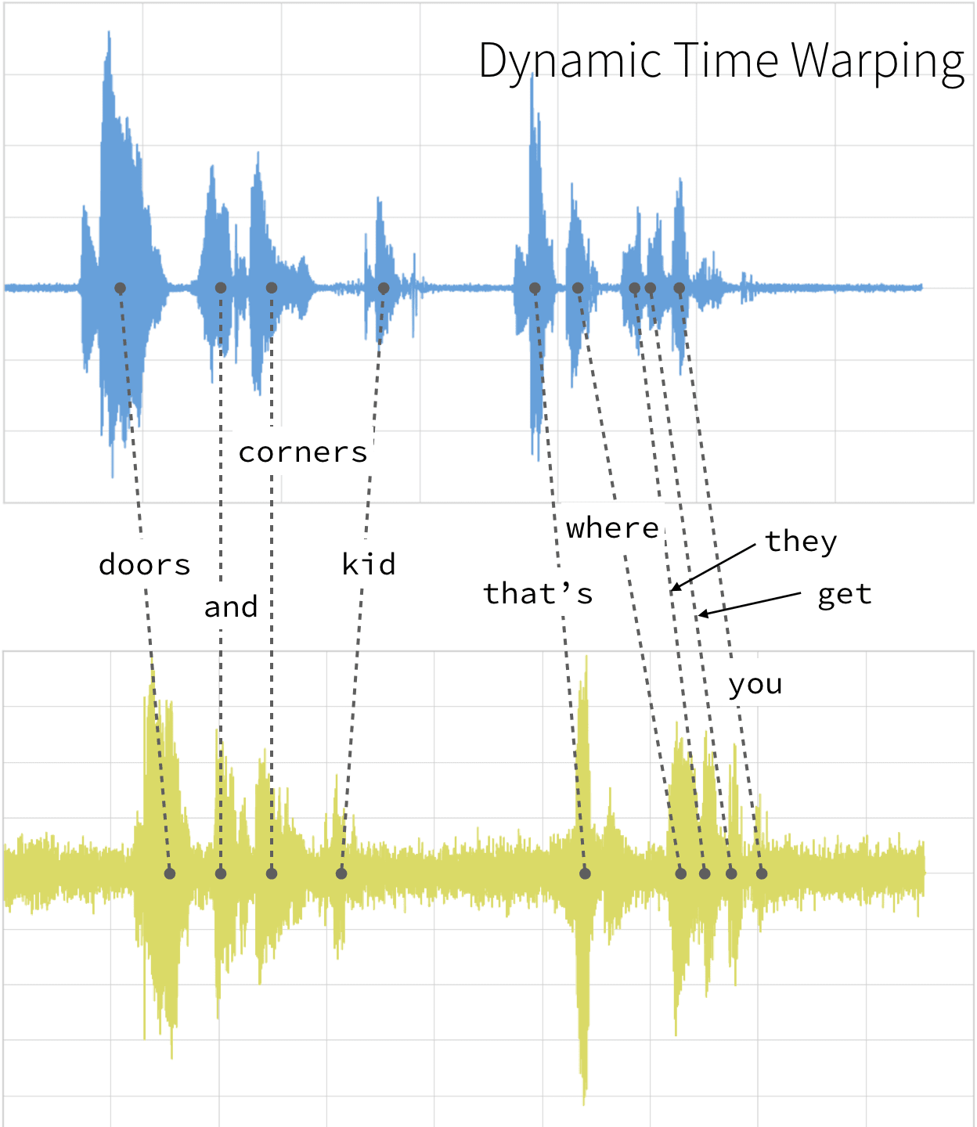
Dynamic Time Warping (DTW)
Sequence Alignment Algorithm.
Accounts for Variations in Writing Rhythm and Structure.
Utilizes Temporal Alignment.
Robust Against Noisy of Fragmented Data.
We are primarily interested in the distance matrix of the two time-series, produced by the algorithm.
Notes:
DTW is a sequence alignment algorithm that accounts for variations in writing style and structure.
It aligns sequences temporally, making it robust against noisy or fragmented data.
Our focus is on the distance matrix, which helps evaluate how similar two time-series representations of texts are.
------------------------------------------------------------------------------
Dynamic Time Warping Introduction: Dynamic Time Warping (DTW) aligns text sequences dynamically, enabling more accurate assessment of writing styles.
widely-used sequence alignment algorithm, originally developed for applications like speech recognition and time-series analysis. It has since been adapted for text analysis tasks, including authorship verification, where it excels in aligning sequences of varying lengths or styles.
Role in Stylistic Analysis: DTW facilitates nuanced stylistic analysis by accounting for variations in writing rhythm and structure.
Temporal Alignment Importance: Utilizing temporal alignment helps improve the authorship verification process across diverse linguistic constructs.
It aligns signals along different temporal scales, allowing both local and global stylistic congruence to be analyzed in depth

Slide 15
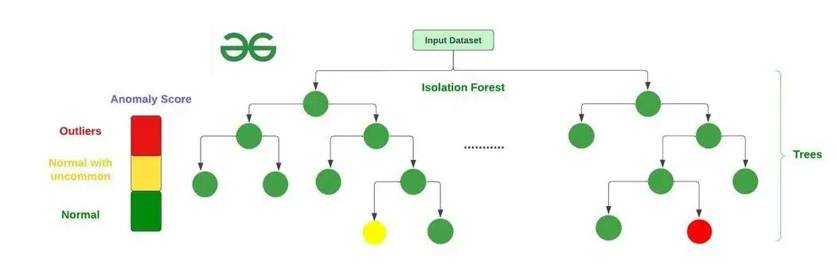
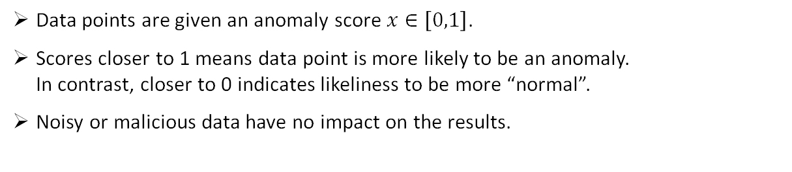
Anomaly Detection
Anomaly detection focuses on finding outliers–data points that are significantly different from the general stylistic patterns in a dataset.
Isolation Forest Algorithm
Data points are given an anomaly score $x∈\left[0,1\right]$.
Scores closer to 1 means data point is more likely to be an anomaly. In contrast, closer to 0 indicates likeliness to be more “normal”.
Noisy or malicious data have no impact on the results.
Notes:
Anomaly detection helps identify outliers in writing styles.
We use the Isolation Forest algorithm, which isolates anomalies effectively.
By detecting significant deviations in writing patterns, we can determine if a document truly belongs to an author.
------------------------------------------------------------------------------
Isolation Forest Application: Isolation Forest effectively identifies anomalies in authorship data, isolating suspicious writing patterns from genuine texts.
Isolation Forest performs the isolation of the observations by randomly choosing a feature and then randomly choosing a split value between the maximum and minimum values of that feature. Every data point is given an anomaly score that reflects how isolated it is within the random partitioning structure developed by the model.
Noisy or Malicious Data: By isolating observations through random partitioning of the feature space, Isolation Forest is able to spot outliers with high efficiency in large datasets - a common scenario in authorship verification - guaranteeing that noisy or malicious data will not affect the result of the verification.
Isolation Forest Algorithm
Formally, the anomaly score s(x) for a point x is derived by:
Path Length: Calculating the path length h(x) from the root to the terminating node in each tree.
Average Path Length: Averaging h(x) across T trees to obtain h(x).
Normalization: Converting h(x) into a score between [0, 1] by comparing it to the expected path length of a random observation, often approximated by a function c(n) dependent on the dataset size n.
$$s\left(x\right)=2^{−\frac{\overline{h}\left(x\right)}{c\left(n\right)}}$$

Slide 16
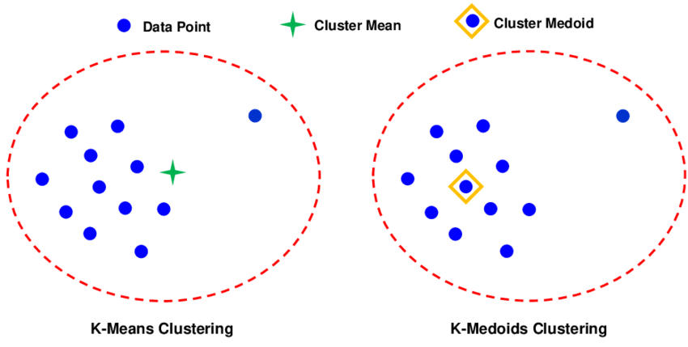
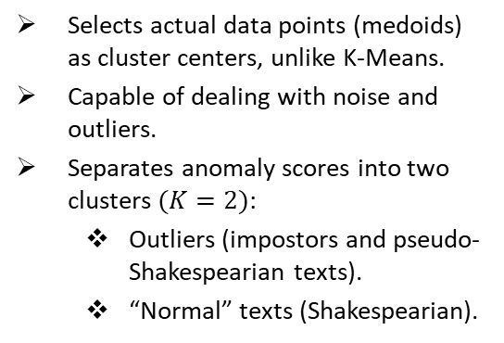
Clustering
Clustering groups data points based on similarity, addressing noise and outliers effectively.
K-Medoids Clustering Algorithm
Selects actual data points (medoids) as cluster centers, unlike K-Means.
Capable of dealing with noise and outliers.
Separates anomaly scores into two clusters $(K=2)$:
Outliers (impostors and pseudo-Shakespearian texts).
“Normal” texts (Shakespearian).
Notes:
Clustering organizes texts into meaningful groups based on similarity.
This approach handles noise and outliers efficiently.
We use the K-Medoids algorithm to create robust clusters and categorize texts into groups of interest.
Explain two clusters (Outliers and Normal).
------------------------------------------------------------------------------
K-Medoids Clustering: K-Medoids clusters authored texts by similarity, enhancing the identification of distinctive authorial styles through grouping.
Unlike K-means, which makes use of centroids as the representative of the cluster, which is sensitive to outliers, the K-medoids algorithm selects actual data points (medoids) as the cluster centers to minimize the sum of pairwise dissimilarities between points and their assigned medoids.
Integration for Robustness: Combining Isolation Forest and K-Medoids boosts robustness in detecting novel anomalies while refining clustering efficacy.
K-medoids clusters these scores into stylistically coherent groups, effectively separating between the “normal” texts-which would have low anomaly score-from probably adversarial or outlier texts that would present high anomaly scores. K-medoids ensures that that the clustering is reliable even in the presence of noisy or deceptive inputs by aiming at minimizing dissimilarity around robust medoids.
K-Medoids Algorithm
Initialization: Randomly select k points from the dataset as initial medoids.
Assignment: Assign each data point to the cluster represented by the nearest medoid, based on a dissimilarity measure.
Update: For each cluster, calculate the total dissimilarity for each point in the cluster to all other points in the cluster. Next, replace the medoid with the point that minimizes the total dissimilarity if such a replacement reduces the overall clustering cost.
Iteration: Repeat the assignment and update steps until the medoids stabilize or the clustering cost converges.
Output: The final clusters and their medoids.

Slide 17
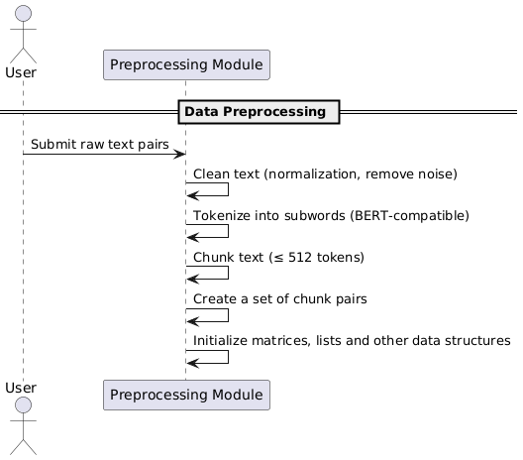
Sequence Diagrams
Notes:
This slide provides a sequence diagram for our data preprocessing.
Starting from raw text pairs …
------------------------------------------------------------------------------

Slide 18
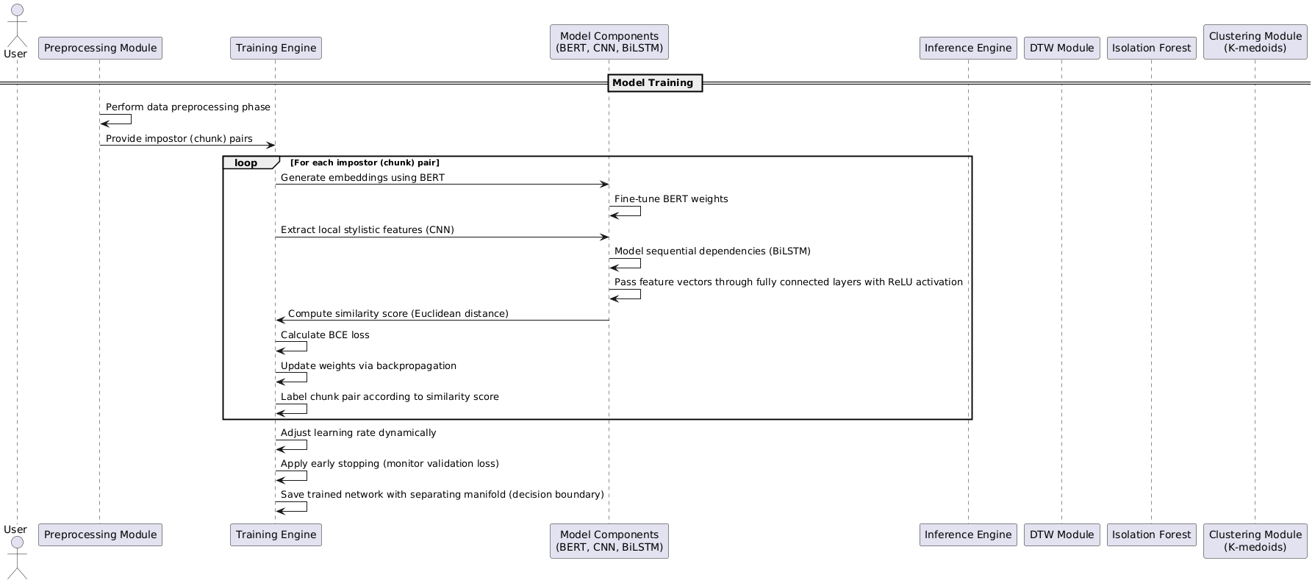
Sequence Diagrams Contd.
Notes:
Next, in this slide we have a sequence diagram for our model training.
After the data was preprocessed, the model looping through each chuck pairs of the Impostor pair…
------------------------------------------------------------------------------

Slide 19
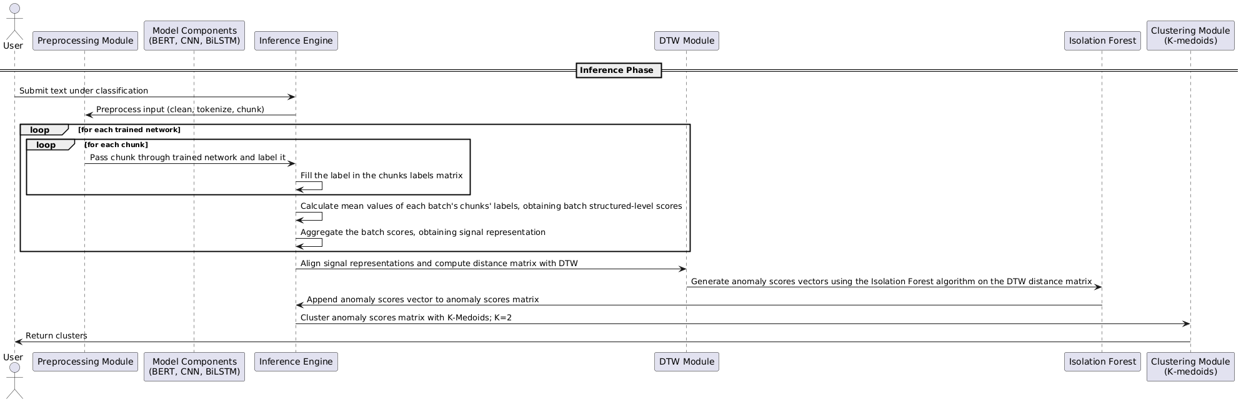
Sequence Diagrams Contd.
Notes:
In this slide we have a sequence diagram for our model inference phase.
Starting from submitting text under classification, to preprocessing the input.
We pass each chunk through the trained network, and label it.
We calculate batch structured-level scores (by mean values of chunks labels) and obtain signal representation.
We align signal representations, and compute distance matrix with DTW.
Next, generating anomaly scores by using Isolation Forest on the DTW matrix.
Append anomaly scores vector to anomaly scores matrix.
Finally, we cluster the anomaly scores matrix with K-Medoids, when K=2.
------------------------------------------------------------------------------

Slide 20
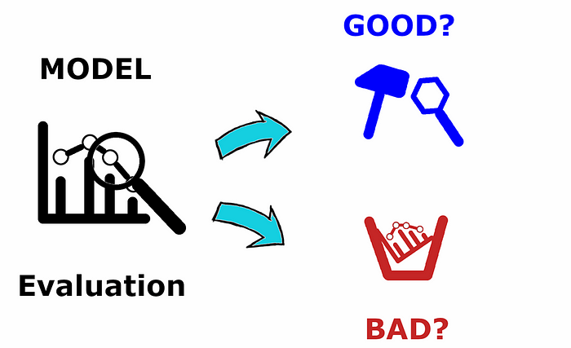
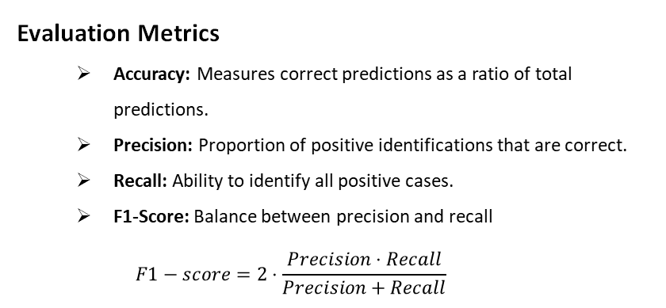
Testing and Evaluation Plan
Evaluation Metrics
Accuracy: Measures correct predictions as a ratio of total predictions.
Precision: Proportion of positive identifications that are correct.
Recall: Ability to identify all positive cases.
F1-Score: Balance between precision and recall
$$F1−score=2⋅\frac{Precision⋅Recall}{Precision+Recall}$$
Planned Tests
Data Preparation.
Model Training.
Network-Components Integration.
Notes:
We have a structured evaluation plan to validate our model.
Key areas include data preparation, model training and network integration.
Each stage ensures robustness and effectiveness in real-world scenarios.
------------------------------------------------------------------------------
Testing Strategies Overview: Employing varied testing strategies effectively assesses the model's resilience to diverse authorship verification scenarios.
Evaluation Metrics Employed: Utilization of precision, recall, F1-score, and AUC ensures a comprehensive understanding of model performance.
Stress Testing Methods: Implementing stress tests simulates extreme conditions, validating the model's robustness against potential vulnerabilities.

Slide 21
Testing and Evaluation Plan Contd.
Data Preparation Tests
Test | Function Tested | Input | Expected Result
Tokenization | Tokenize input texts into valid sub-word tokens | Example text: "Tokenization ensures each text fragment is split into valid sub-word tokens." | All tokens conform to BERT tokenizer (WordPiece) rules
Pairwise Creation | Generate text pairs (genuine and impostor pairs) | Dataset of texts from different authors, e.g., ["Text A by Author 1", "Text B by Author 2", "Text C by Author 1"] | Pairs correctly labeled and stored
Chunking | Divide texts into appropriate-sized chunks | A long text (e.g., 1000+ tokens): "This is a very long input text..." (add sufficient text so its length exceeds 1000 tokens for realistic chunking) | Chunk size 512 tokens
Dataset Integrity Validation | Ensure the dataset has not corrupt or missing entries | Dataset file with various text entries, some valid and some corrupted, e.g., ["Valid Text Entry 1", "", None, "Valid Text Entry 4"] | All rows contain valid text data
Adversarial Cases | Inject mimicry-based adversarial examples for testing | Dataset with adversarial examples, e.g., pairs like ("Text A", "Text A rewritten with mimicry from a different author") | Model identifies adversarial different authors.
Notes:
Data preparation is crucial for training a high-quality model.
We test our preprocessing techniques to ensure data quality.
------------------------------------------------------------------------------

Slide 22
Testing and Evaluation Plan Contd.
Model Training Tests
Test | Function Tested | Input | Expected Result
Siamese Network | Siamese architecture consistency during forward passes | Pair of texts: ("Text A: Example input text", "Text B: Another example text") | Embeddings generated for both inputs
Loss Function | Binary cross-entropy calculation | Model predictions and ground truth labels, e.g. predictions = [0.1, 0.9], labels = [0, 1] | Loss values decrease as epochs progress
Gradient Propagation | Gradients flow through BERT, CNN, BiLSTM layers | Model with architecture including BERT, CNN, and BiLSTM layers, input sequence: "Sample text input for gradient testing." | All layers update weights without errors
Isolation Forest | Train Isolation Forest on DTW-aligned signal matrices (unsupervised) | Dynamic Time Warping (DTW)-aligned signal matrices from time-series data, e.g., [[1.2, 0.5, 1.1], [0.8, 0.9, 1.0], ...] | Models anomaly detection without overfitting
Overfitting Check | Monitor training and validation loss during training | Training and validation datasets with similar distributions, e.g., Dataset 1 (training), Dataset 2 (validation), with labels and features aligned appropriately. | Avoid significant divergence between losses
Early Stopping | Ensure training stops when validation performance hits a plateau | Model training data with early-stopping parameters, e.g., patience = 5 epochs, validation set performance plateauing, such as validation_loss = [0.5, 0.5, 0.5]. | Stops without exceeding patience threshold
Notes:
Testing our model training process.
Testing each component relevant.
------------------------------------------------------------------------------
Testing Strategies Overview: Employing varied testing strategies effectively assesses the model's resilience to diverse authorship verification scenarios.
Evaluation Metrics Employed: Utilization of precision, recall, F1-score, and AUC ensures a comprehensive understanding of model performance.
Stress Testing Methods: Implementing stress tests simulates extreme conditions, validating the model's robustness against potential vulnerabilities.

Slide 23
Testing and Evaluation Plan Contd.
Network-Components Integration
Test | Function Tested | Input | Expected Result
Inference Process | End-to-end process with trained model | Unseen test text or signals, e.g., "This is an example of unseen input for inference testing." | Valid predictions for unseen test data
Signal Aggregation | Aggregating chunk-level scores into batch-level structured signal | Chunk-level scores from model predictions, e.g., scores = [0.85, 0.92, 0.75] for different chunks in a batch. | Batch scores computed correctly
DTW Alignment | Perform DTW alignment on batch signals | Batch of time-series signal matrices, e.g., [[1.1, 0.8, 1.0], [0.7, 0.9, 1.2]], where rows represent signals from different sequences. | Cumulative distance and correct DTW distance matrix
Anomaly Detection | Isolation Forest flags anomalies in aligned signals | Aligned signals or DTW-aligned matrix with normal and anomalous patterns, e.g., [[1.2, 0.8, 0.9], [10.0, 9.8, 9.7]] (second signal represents anomaly). | Correctly flags outliers without overfitting
Notes:
Testing network components integration.
Those tests are needed to ensure all components work together with no problem.
------------------------------------------------------------------------------
Testing Strategies Overview: Employing varied testing strategies effectively assesses the model's resilience to diverse authorship verification scenarios.
Evaluation Metrics Employed: Utilization of precision, recall, F1-score, and AUC ensures a comprehensive understanding of model performance.
Stress Testing Methods: Implementing stress tests simulates extreme conditions, validating the model's robustness against potential vulnerabilities.

Slide 24

Expected Achievements
Possibility to Generalize the Model
Robustness to Mitigate Shortcomings of Traditional Methods.
Scalability and Adaptability to Noisy and Fragmented Texts.
Provide a Solution to the Shakespeare Apocrypha Controversy.
Notes:
Our model aims to improve over traditional methods by enhancing robustness.
It adapts well to noisy and fragmented texts, making it highly scalable.
A key goal is to provide solutions for complex authorship verification cases, like the Shakespeare Apocrypha controversy.
------------------------------------------------------------------------------
Enhanced Accuracy Expectations: Predicted improvements indicate significant enhancement in accuracy metrics through advanced analytical methodologies and innovative techniques.
Robustness Across Domains: Framework's adaptability ensures robust performance across varied domains, effectively handling diverse linguistic and stylistic elements.
Scalability Advantages: The proposed framework is designed for scalability, accommodating increasing datasets while maintaining efficient processing capabilities.

Slide 25

Conclusions and Future Plans
Introduced a state-of-the-art neural network for authorship verification.
Employed a versatile adversarial training technique.
Innovative inference pipeline based on robust algorithms and techniques.
Attempted addressal of important limitations of traditional methods.
Notes:
We introduced a novel neural network approach for authorship verification.
Our method combines deep learning, anomaly detection and clustering.
We addressed limitations of traditional methods and proposed an improved inference pipeline.
Future work includes refining models further and expanding applicability.
------------------------------------------------------------------------------
Recap of Key Innovations: Innovations include Siamese networks and adversarial training enhancing authorship verification's accuracy and robustness.
Future Research Directions: Future research will focus on refining methodologies and expanding model capabilities in diverse applications.
Collaboration Opportunities: Encouraging interdisciplinary collaboration can foster innovation and application of authorship verification techniques broadly.

Slide 26


Thanks for Listening
Notes:
Thanks for listening!
Any questions?

